Slide 1
Predicting APS failure of Scania truck
Team name : The Technocrats
Group members:
Md. Masudur Rahman (1631189042)
Saraf Sumaita Hasan (1631258042)
Md Rifat Hasan (1620259042)
Rehnuma Sharmin (1620739042)

Slide 2
Dataset explanation
Problem Discussion
Data preprocessing
Model Implementation
Result Analysis
Summary
Table of Contents

Slide 3
Dataset Explanation
Collected from the Industrial Challenge for IDA 2016
Collected from heavy Scania trucks in everyday usage.
Contains a training and test set
Attribute names have been anonymized for proprietary reasons
Consists of both single numerical counters and histograms consisting of bins with different conditions
Subset of all available data, selected by experts

Slide 4
Dataset Explanation
Characteristics : Multivariate
Attribute Characteristics: Integer, Real
Associated Task: Classification
Training dataset :
Number of Features : 171
Records : 60,000
Features : Anonymized
Type : Labeled
Testing dataset :
Number of Features : 171
Records : 16000
Features : Anonymized
Type : Labeled

Slide 5
Problem Discussion
The system in focus is the Air Pressure system (APS) which generates pressurized air that are utilized in various functions in a truck, such as braking and gear changes.
Classification problem (2 classes – Positive and Negative)
The positive class consists of component failures for a specific component of the APS system.
The negative class consists of trucks with failures for components not related to the APS.

Slide 6
Problem Discussion
Our main task is to find that the failure is APS related or not
And
Thus to find the misclassification and the penalty for having these misclassification and to minimize them
Failure –
Type 1 failure – False Positive (Penalty of 10)
Type 2 failure – False Negative (Penalty of 500)
Total cost = 10 * No of instances of Type 1 Failure + 500 * No of instances of Type 2 Failure

Slide 7
Challenges
High quantity of missing values
High imbalance in the class distribution

Slide 8
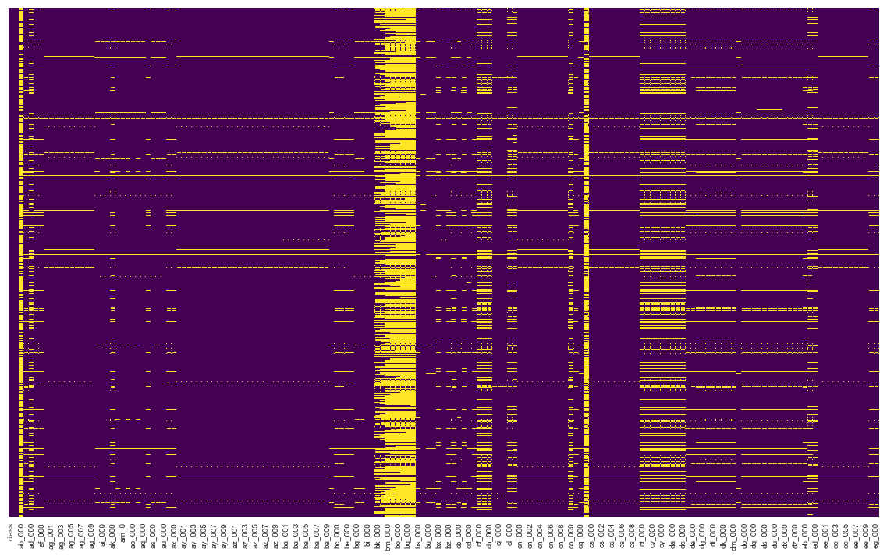
Data Preprocessing
Heatmap for Missing Values’ Representation
This graph representing missing values over the full dataset in yellow line

Slide 9
Data Preprocessing
For handling the missing values –
Replace all the missing values with their corresponding mean

Slide 10
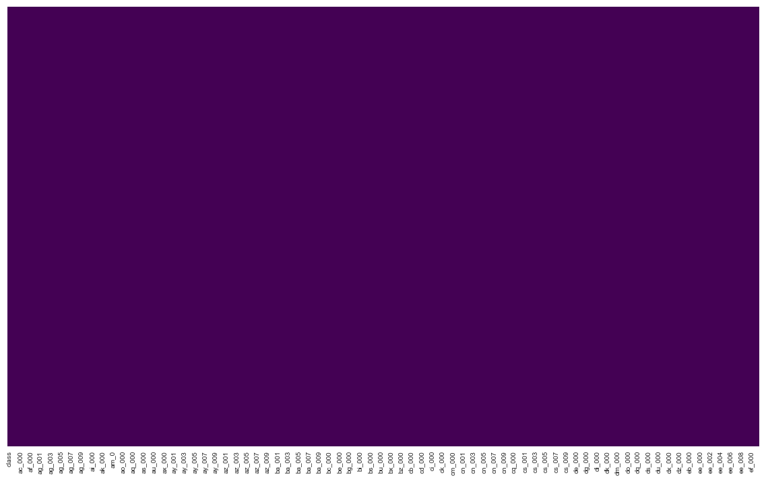
Data Preprocessing
After replacing all the missing values with their corresponding mean values ,
Heatmap for Missing Values’ Representation

Slide 11
Data Preprocessing
What will happen to the response class ?
Dummy variables ?
class | aa_000 | ab_000 | ac_000 | ad_000 | ae_000 | af_000 | ag_000 | ag_001 | ag_002
0 | 76698 | 0.713189 | 2.13E+09 | 280 | 0 | 0 | 0 | 0 | 0
0 | 33058 | 0.713189 | 0 | 190620.64 | 0 | 0 | 0 | 0 | 0
0 | 41040 | 0.713789 | 228 | 100 | 0 | 0 | 0 | 0 | 0
0 | 12 | 0.000000 | 70 | 66 | 0 | 10 | 0 | 0 | 0
0 | 60874 | 0.713189 | 1368 | 458 | 0 | 0 | 0 | 0 | 0
Sample data representation

Slide 12
Model Implementation
Implemented models :
Logistic Regression
Support Vector Machine
Random Forest

Slide 13
Logistic Regression
Dividing this into 4 subsections –
Accept the challenge
Set the parameter “C”
Setting the threshold from ROC-AUC curve
Generate the result
Notes:
The set is very unbalanced with one label (0) being more frequent than the other (1). The algorithm needs to adjust for that. It is done using 'class_weight' hyperparameter which is the ratio of number of 0s to 1s in the label.
'C', a hyperparameter (parameter) of the Logistic Regression algorithm.

Slide 14
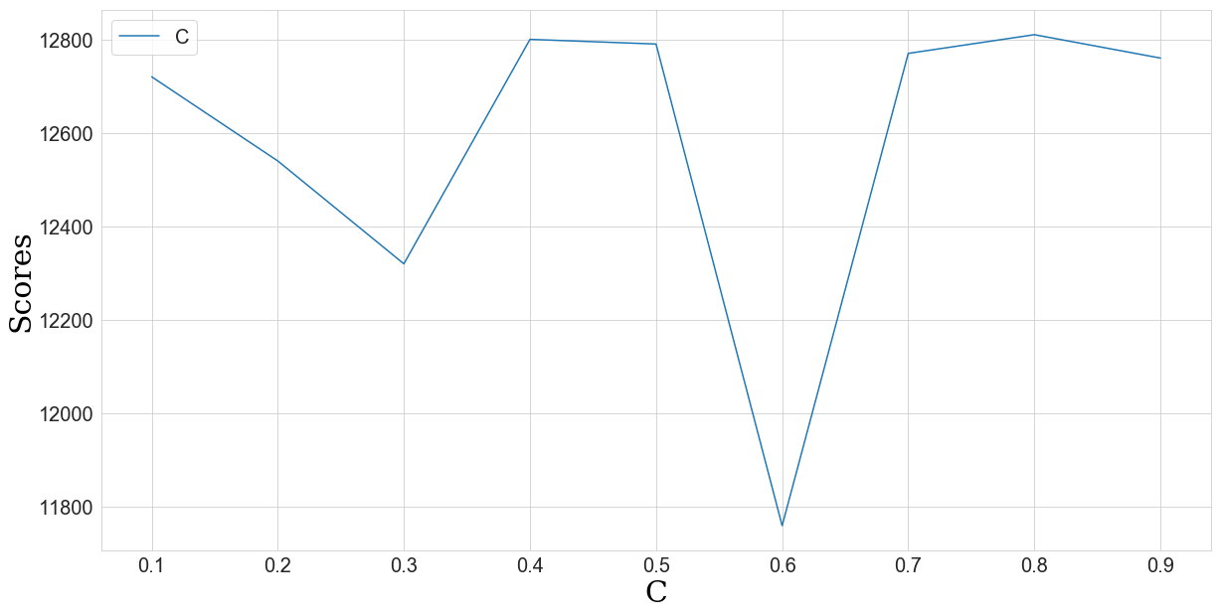
Logistic Regression
Apply CV to determine the optimal value for the parameter “C”

Slide 15
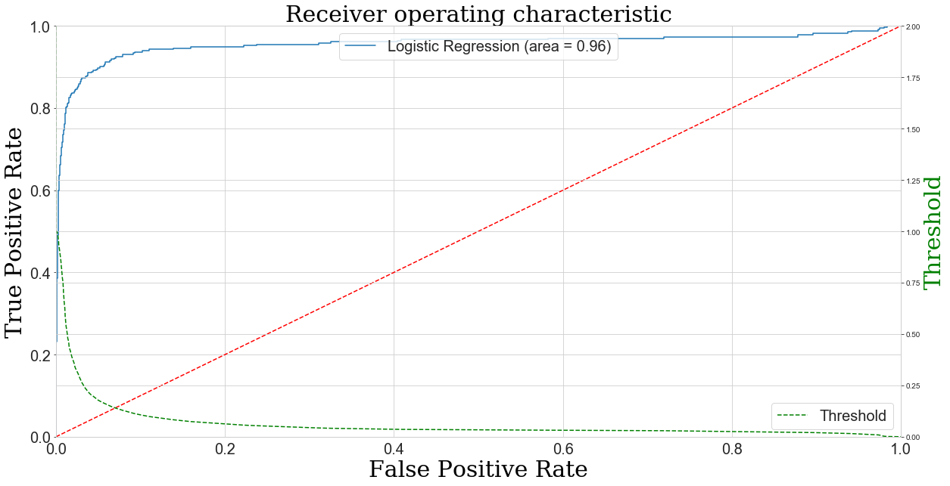
Logistic Regression
Setting the threshold
0.42~0.45

Slide 16
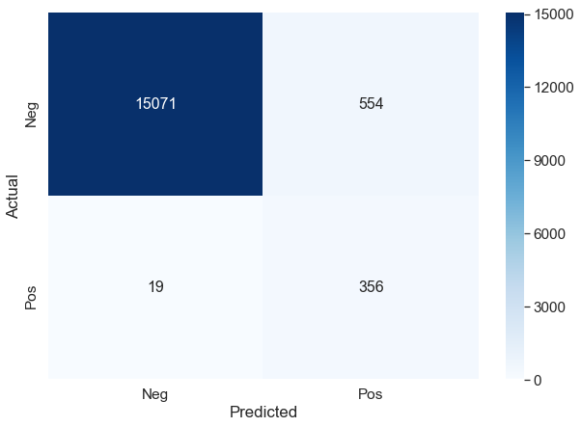
Logistic Regression
Result
Score | Number of Type 1 fault | Number of Type 2 fault
15040 | 554 | 19

Slide 17
Logistic Regression
Result

Slide 18
Support Vector Machine
Dividing this into 4 subsections –
Standardization of Data
Principal Component Analysis (Optimal n component)
Tuning of the parameters
Test Data implementation

Slide 19
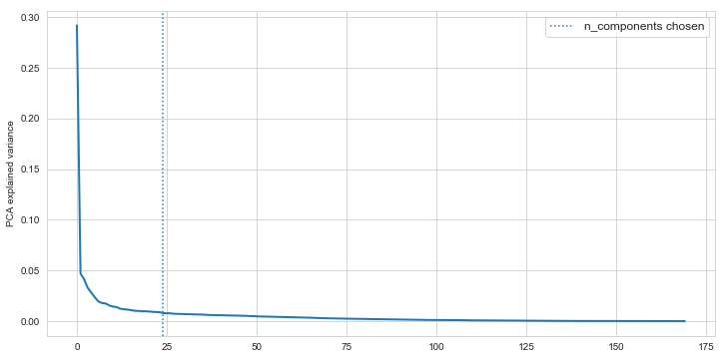
Support Vector Machine
Principal Component Analysis
Optimal n component ?
PCA explained variance
PCA n component
24

Slide 20
Support Vector Machine
Parameters Optimization
At this point, we put PCA and out Classifier model into a pipeline for performing a GridsearchCV and to optimize our classifier’s parameters such as “gamma” , “C”

Slide 21

Support Vector Machine
Result
Score | Number of Type 1 fault | Number of Type 2 fault
15220 | 522 | 20

Slide 22
Support Vector Machine
Result

Slide 23
Random Forest
Dividing this into 4 subsections –
Feature Selection
Determining the number of trees
Test Data implementation

Slide 24
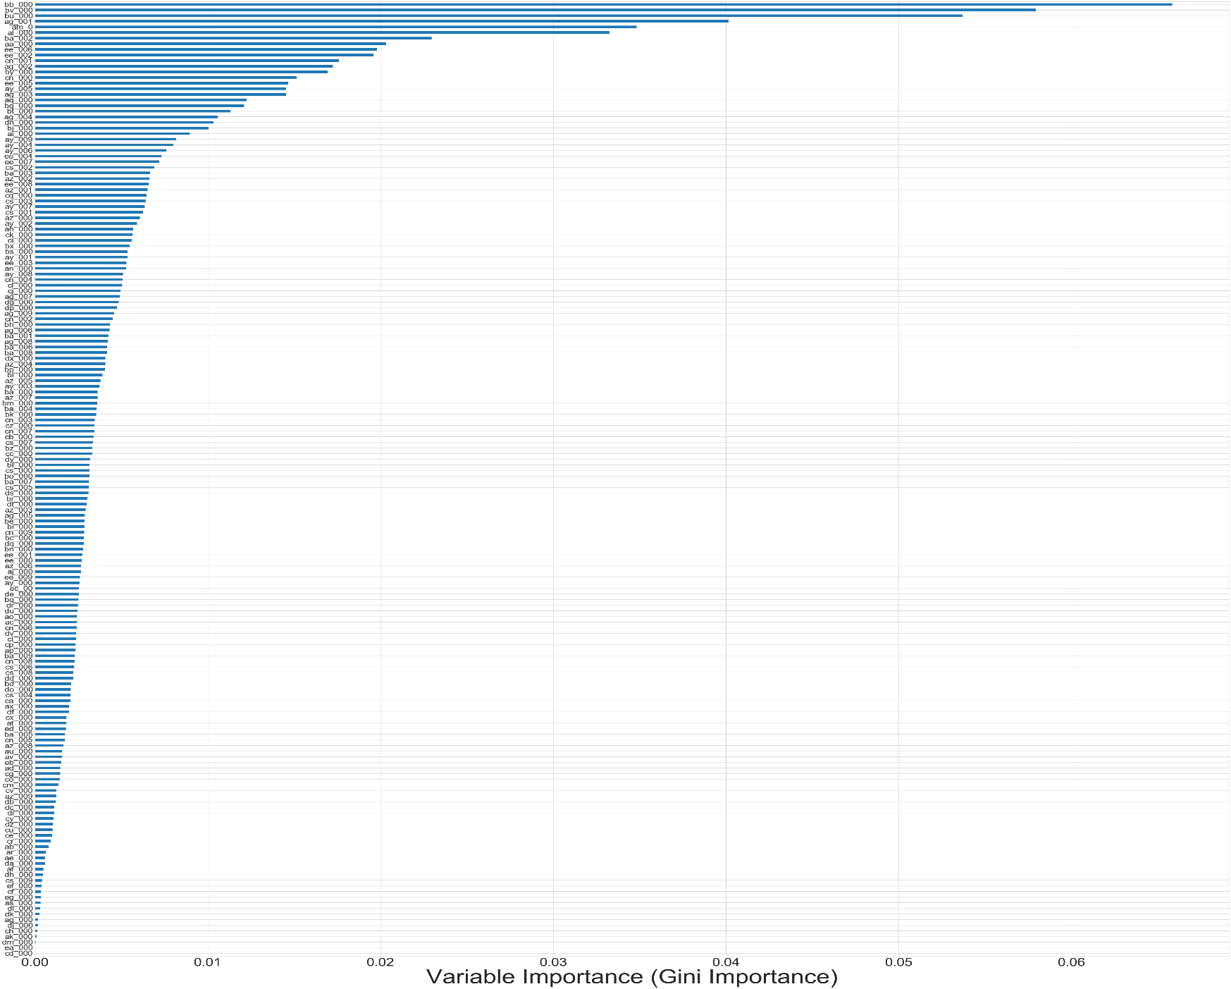

Variable Importance (Impurity Criterion: Gini)
Random Forest
For all 170 features
Not all features are relevant
So we carry out Feature Selection

Slide 25
Random Forest
Feature Selection using SelectFromModel
It is a Meta-transformer that selects features based on importance weights.
Features whose importance is greater or equal to the threshold are kept while others are discarded.
The default threshold value is the mean of the feature importances.

Slide 26
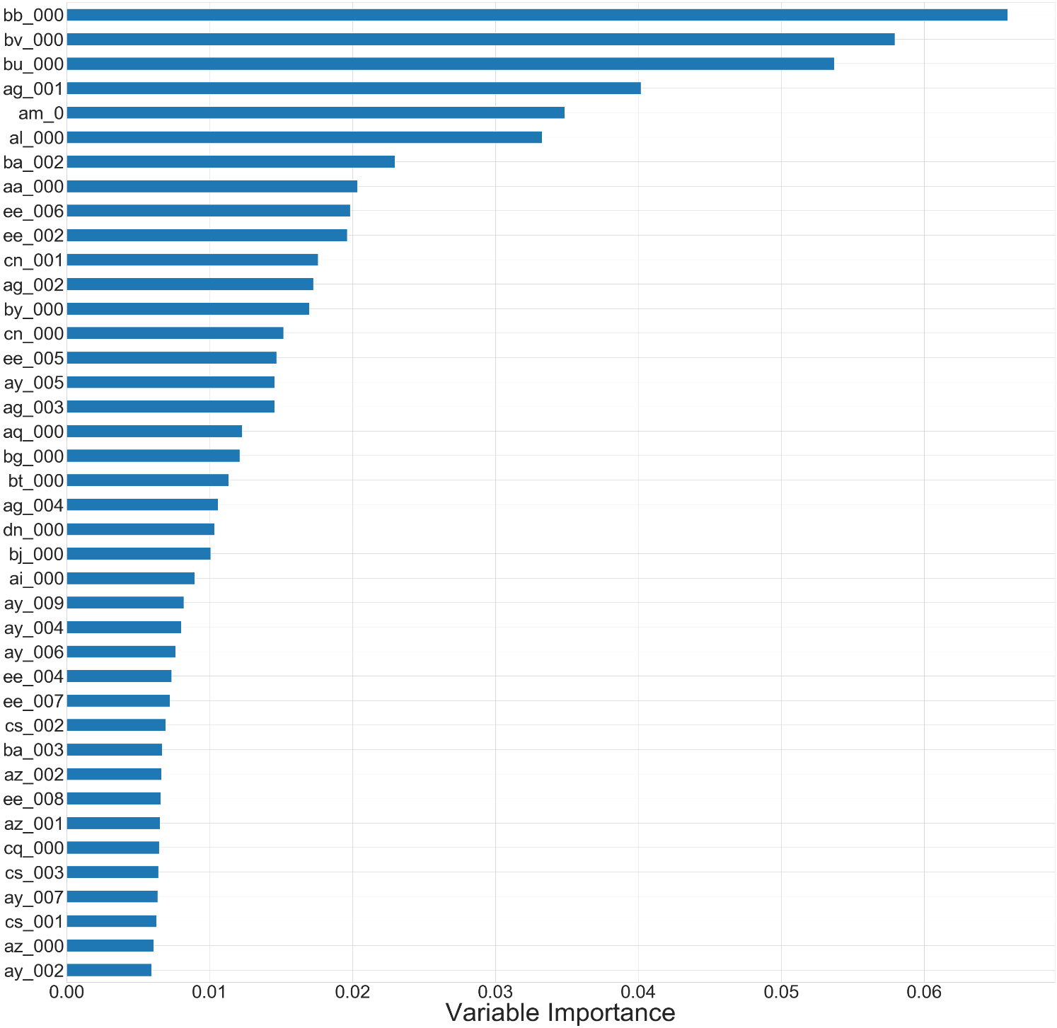
Post-Feature Selection
Random Forest
Only 40 features now
Cross Validation was done both
the times to compare the
performances
A reduce in total cost was
achieved with these
selected features.

Slide 27
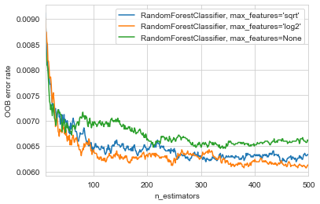
Number of trees (n_estimators) ?
Random Forest
From the observation
of the curves,
the suitable parameters
were determined
max_features= log2
N_estimators= 380
380

Slide 28
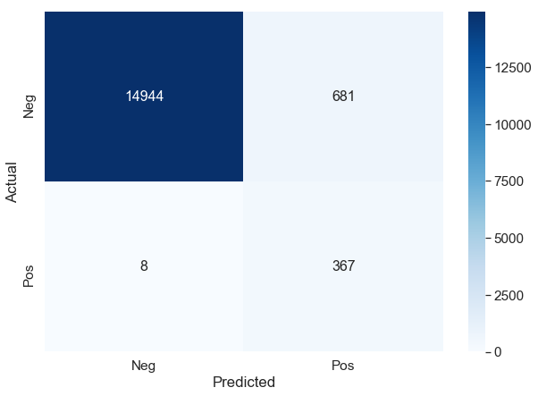
Random Forest
Result
Score | Number of Type 1 fault | Number of Type 2 fault
10810 | 681 | 8

Slide 29
Random Forest
Result

Slide 30
Model Comparison
We have used three models to solve our problem.
Among them, Logistic Regression and Support Vector Classifier gives us almost the same result
Random Forest Classifier gives us the best result

Slide 31
Fault Types Comparison

Slide 32
Evaluation Score Comparison

Slide 33
Cost Comparison

Slide 34
Summary and Conclusion
So after observing all these three models, it is observable that all of these three models eventually giving a very close result to one another.
If we see individual scores then it’s hard to distinguish between them, but if we see as a combination then Random Forest is giving the best result.
With the optimal settings of Random forest we got the cost of 10810 which is almost our desired result which was the cost of 9020.

Slide 35
References
Breiman, L.: Random Forests. In: Machine Learning. Vol. 45,No. 1, pp. 5-32. (2001)
Cox, D.R.: The regression analysis of binary sequences. J. R. Stat. Soc.Ser. B 20(2), 215–242 (1958).
Aizerman, pM.A., Braverman, E.A., Rozonoer, L.: Theoretical foundations of the potential function method in pattern recognition learning. In: Automation and Remote Control, pp. 821–837 (1964)
Boser, B.E., Guyon, I.M., Vapnik, V.N.: A training algorithm for optimal margin classifiers. In: Proceedings of the 5th COLT, pp. 144–152 (1992)
Ho, T.K.: Random decision forests. In: Proceedings of the 3rd IJDAR,pp. 278–282 (1995)
Zhang Z.: Missing data imputation: focusing on single imputation. Ann Transl Med. 2016;4(1):9. DOI:10.3978/j.issn.2305-5839.2015.12.38
Breiman, L.: Random Forests. In: Machine Learning. Vol. 45, No. 1, pp. 5-32. (2001)
Mayumi Oshiro, Thais & Santoro Perez, Pedro & Baranauskas, José. (2012). How Many Trees in a Random Forest?. Lecture notes in computer science. 7376. 10.1007/978-3-642-31537-4_13.

Slide 36
Thank you

